Slide 1
LEARNING MANAGEMENT SYSTEM
Spring Boot Backend Project
Presented By
Ashwin Krishna.V
III rd Year – CSE E
B.E. Computer Science and Engineering
Sri Krishna College of Technology

Slide 2
Table of Contents
Introduction
Problem Statement
Project Objectives
UML Diagrams
Functional Implementation — API Endpoints
Swagger UI - api-controller

Slide 3
Introduction
The Learning Management System (LMS) is a web-based application developed to improve the learning process in educational institutions. It allows students to access study materials, submit assignments, and attend quizzes online. Instructors can manage courses and monitor student progress efficiently. The system provides a centralized platform for teaching and learning activities. The project aims to make education more accessible, organized, and interactive through digital technology.
Key Features
* Course Management
* Assignment Management
* Quiz Management
* Student Progress Tracking

Slide 4
Problem Statement
To develop a centralized platform for managing courses, assignments, quizzes, and student progress efficiently in an online learning environment.
Challenges:
* User Authentication and Authorization
* Course and Content Management
* Assignment and Quiz Handling
* Tracking Student Progress and Performance
Proposed Solution
To develop a web-based Learning Management System that provides a centralized platform for managing courses, assignments, quizzes, and student progress efficiently and securely.

Slide 5
Project Objectives
RESTful API Design
Develop REST APIs using Spring Boot for adding, retrieving, and approving certificate requests.
Data Persistence
Store certificate request details securely in a relational database using JPA/Hibernate with auto-generated IDs.
Request Status Management
Ensure every new request is assigned PENDING status and can be updated to APPROVED by the administrator.
Frontend–Backend Integration
Enable seamless communication between the React frontend (Port 8081) and Spring Boot backend (Port 8080) using REST APIs.
Layered Architecture
Implement a clean MVC architecture with Configuration, Controller, Service, Repository, and Model layers for better maintainability.
Exception Handling
Return appropriate HTTP status codes such as 200 OK, 400 Bad Request, 404 Not Found, and 500 Internal Server Error for reliable API responses.

Slide 6
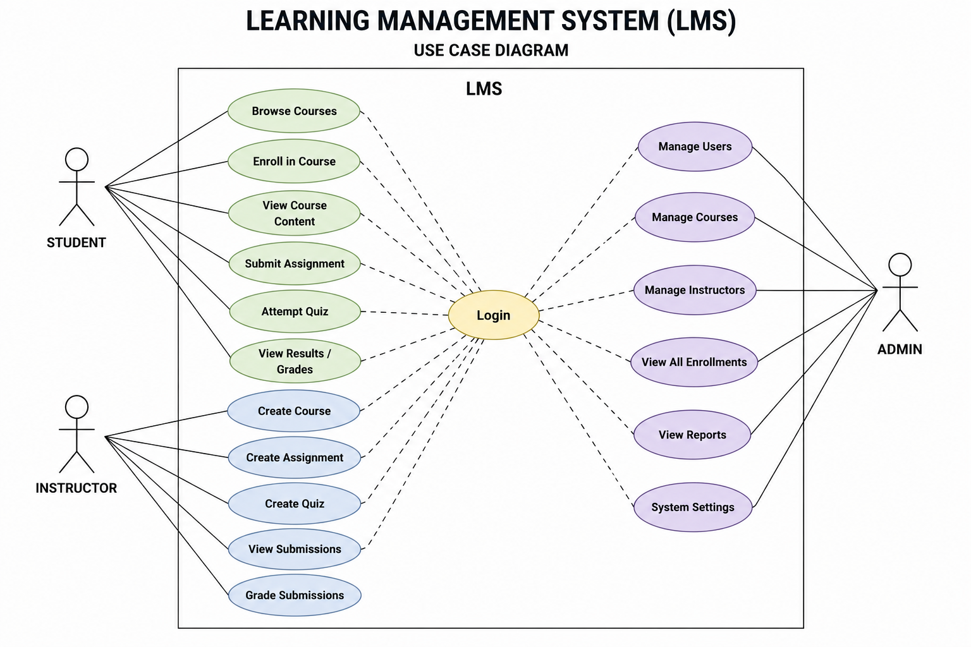
UML Diagrams
Use Case Diagram
Illustrates the interactions between the Student and Admin with the system. It represents the major functionalities such as submitting certificate requests, viewing requests, and approving requests.

Slide 7
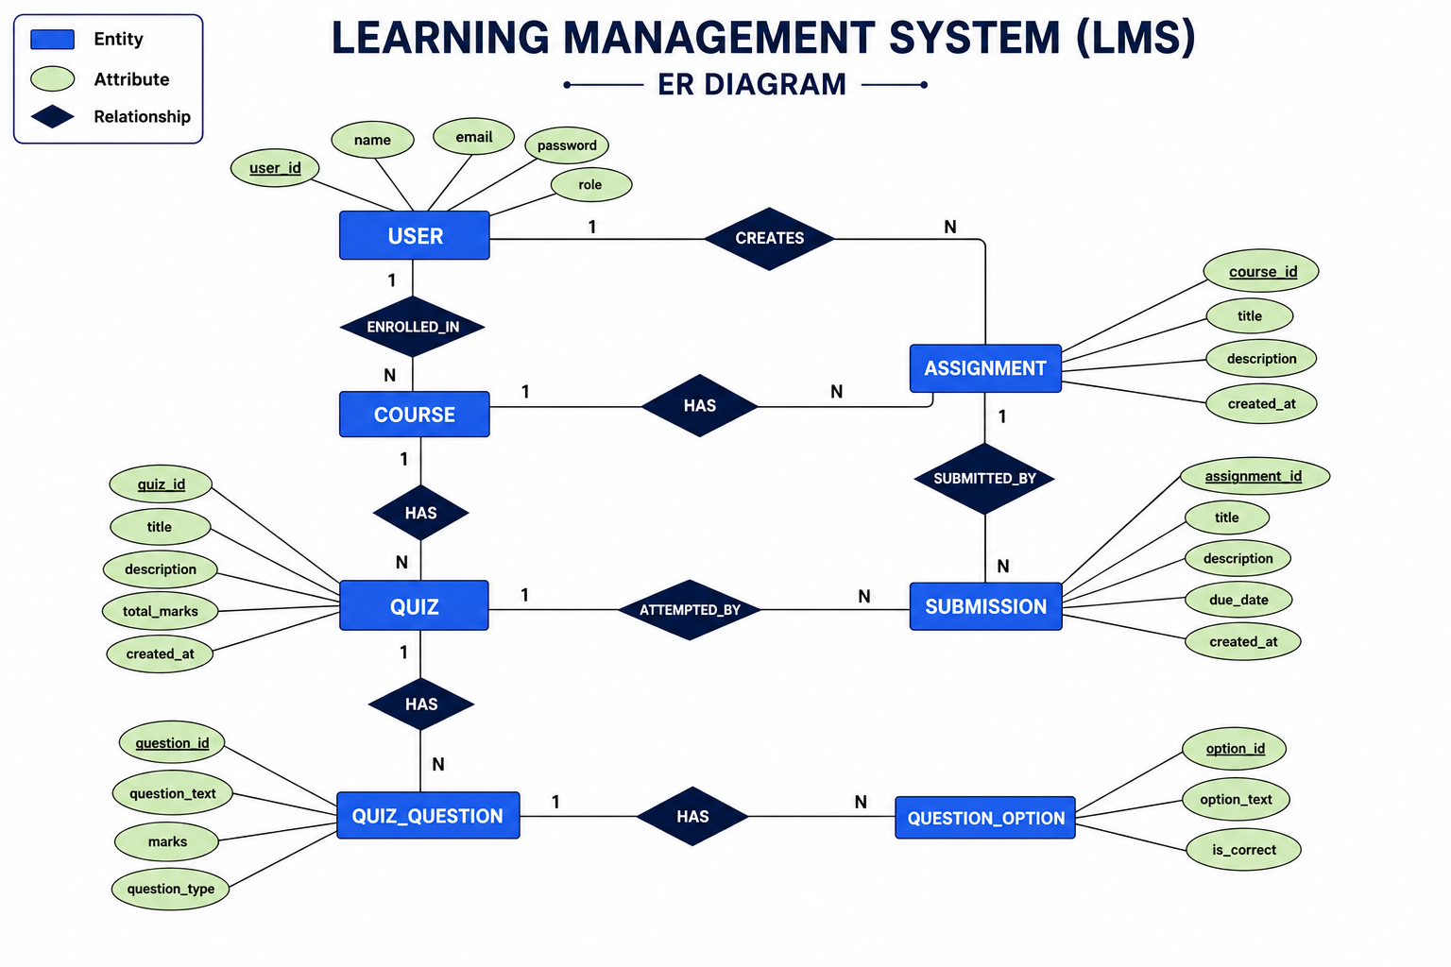
ER Diagram
Represents the database structure of the application. It shows the entities, attributes, and relationships involved in storing certificate request information.

Slide 8
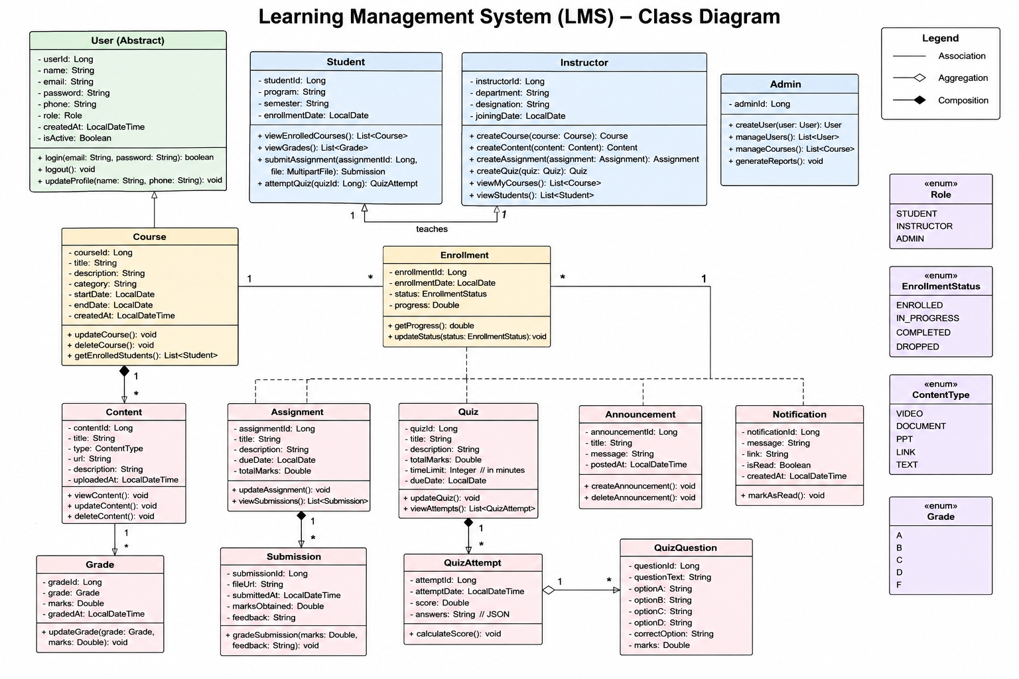
Class Diagram
Depicts the object-oriented structure of the application, including the Model, Repository, Service, Controller, and their relationships in the Spring Boot MVC architecture.

Slide 9
Functional Implementation — API Endpoints
API Endpoints & Swagger
REST API Endpoints:
POST /addRequest – Submit a new certificate request.
GET /getAllRequests – Retrieve all certificate requests.
PUT /approveRequest/{id} – Approve a certificate request by ID.
Swagger Documentation
Provides an interactive interface to test REST APIs.
Displays available endpoints, request parameters, and responses.
Simplifies API testing and backend validation without additional tools.

Slide 10
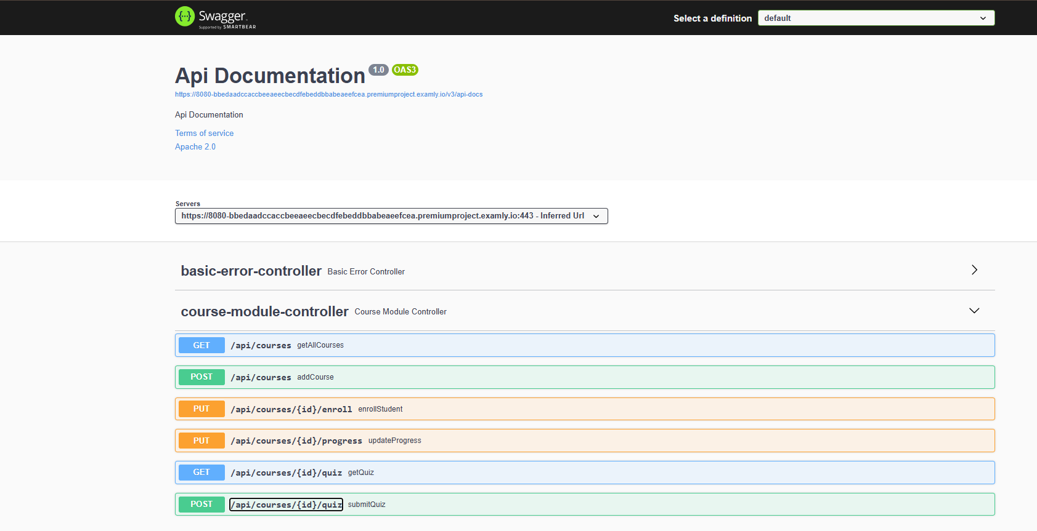
Swagger UI - api-controller

Slide 11
Thank you
Ashwin Krishna.V
727824TUCS031
III CSE – E

